Slide 1

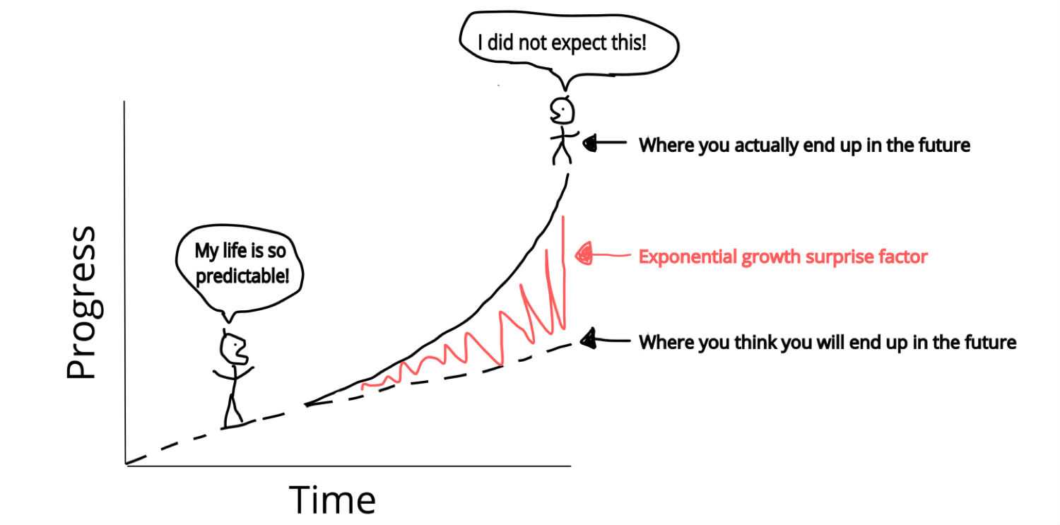
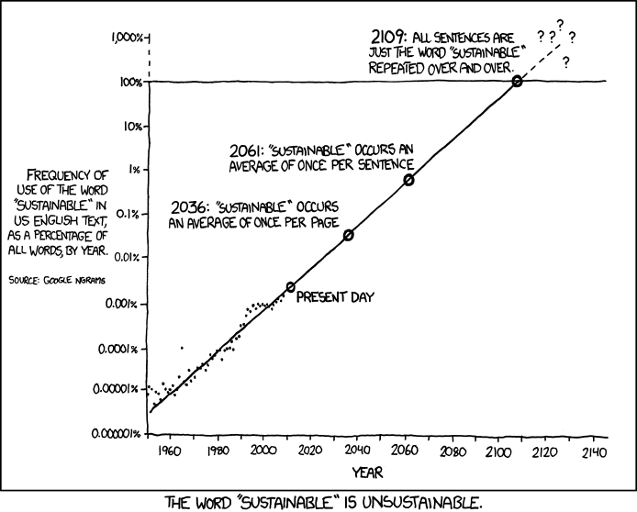
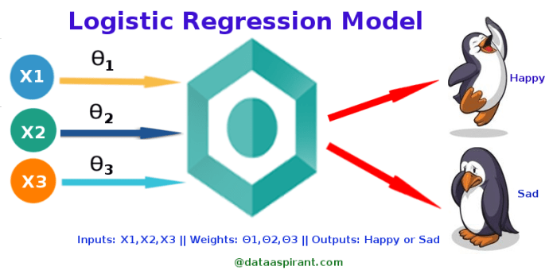
Regression
Discovery and Learning with Big Data/Data Discovery

Slide 2
What do you think?
How much income increase do you expect depending on the years of experience?
What is the impact of a 20% discount on your company's sales numbers?
How much the death rate of children will be affected if the government increase the food support for the parents 10%?
How much the price of the house increase/decrease by the size of the house?
If universities provide 5 more programs for mental health what will be the change in the student drop out?

Slide 3
Answers: Regression Analysis
These are million-dollars questions
Regression analysis is an important type of data analysis
It is a statistical procedure
Finds an equation showing how two or more variables are related.
Predicts the value of the response variable from explanatory variables
Using a hypothetical model of the linear relationship between response and predictors.
Using the equation of a straight line
Mostly used for
prediction,
modeling, and
testing purposes.

Slide 4
Regression Analysis
Which factors matter most for
the income,
the company sales numbers,
the death rate of children,
the price of a house,
the dropouts, etc.
Which factors can be ignored.
How certain we are about all these factors.

Slide 5

Input/Output Features and relationships
When analyzing data, some features
may be interrelated and
have a cause-and-effect relationship.
To investigate potential relationships between features:
input feature: Controlled
output feature/response: Observed

Slide 6

Input/Output Features and relationships
Use a scatter plot of two features to explore the relationships
input feature: x-axis
output feature: y-axis.
Relationship in a scatter plot can provide
Direction: Positive/Negative
Form: Linear/Nonlinear
Strength: Strong/Weak/Moderate
Unusual instances that do not follow the pattern!!! Error or normal?

Slide 7

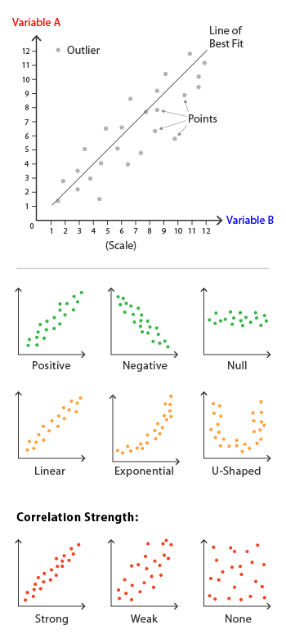
Input/Output Features and relationships
Determine if input and output are correlated.
Use regression analysis to make predictions for the output for given values of input.
Use various goodness-of-fit measures to determine the regression model that best fits the data.
Notes:
https://datavizcatalogue.com/methods/scatterplot.html

Slide 8

Simple Linear Regression(LR)

Slide 9
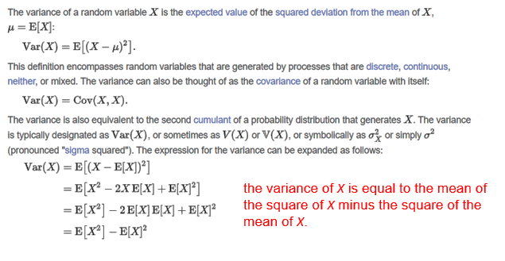
Reminders: Covariance

Slide 10

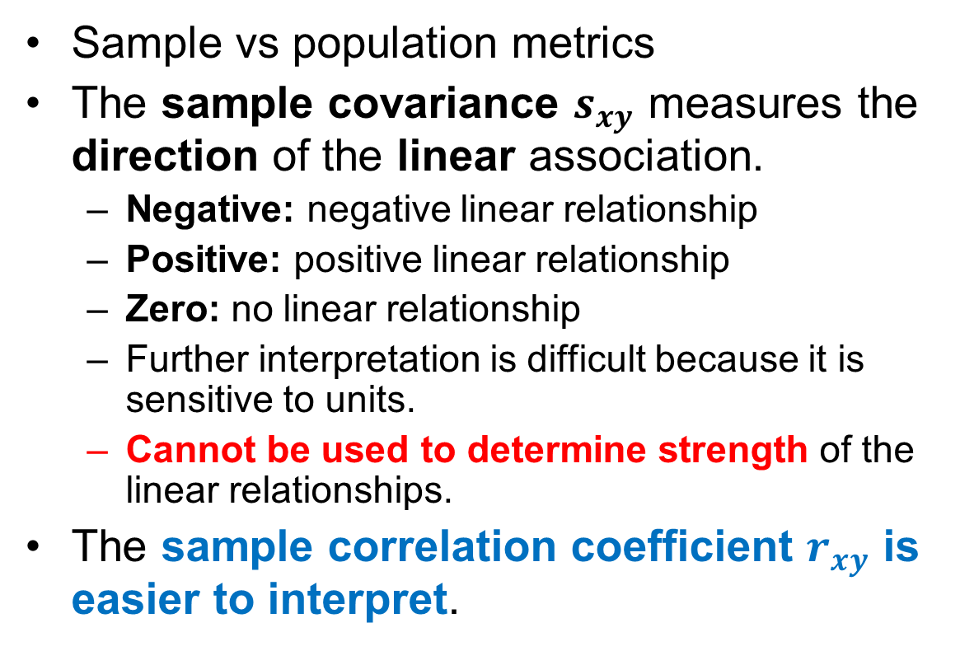
Covariance vs. Correlation Coefficient
Sample vs population metrics
The sample covariance $s_{xy}$ measures the direction of the linear association.
Negative: negative linear relationship
Positive: positive linear relationship
Zero: no linear relationship
Further interpretation is difficult because it is sensitive to units.
Cannot be used to determine strength of the linear relationships.
The sample correlation coefficient $r_{xy}$ is easier to interpret.

Slide 11
Correlation and Scatterplot
The scatterplot visualizes the correlation
The correlation coefficient quantifies the linear association between variables

Slide 12
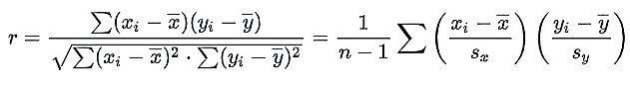
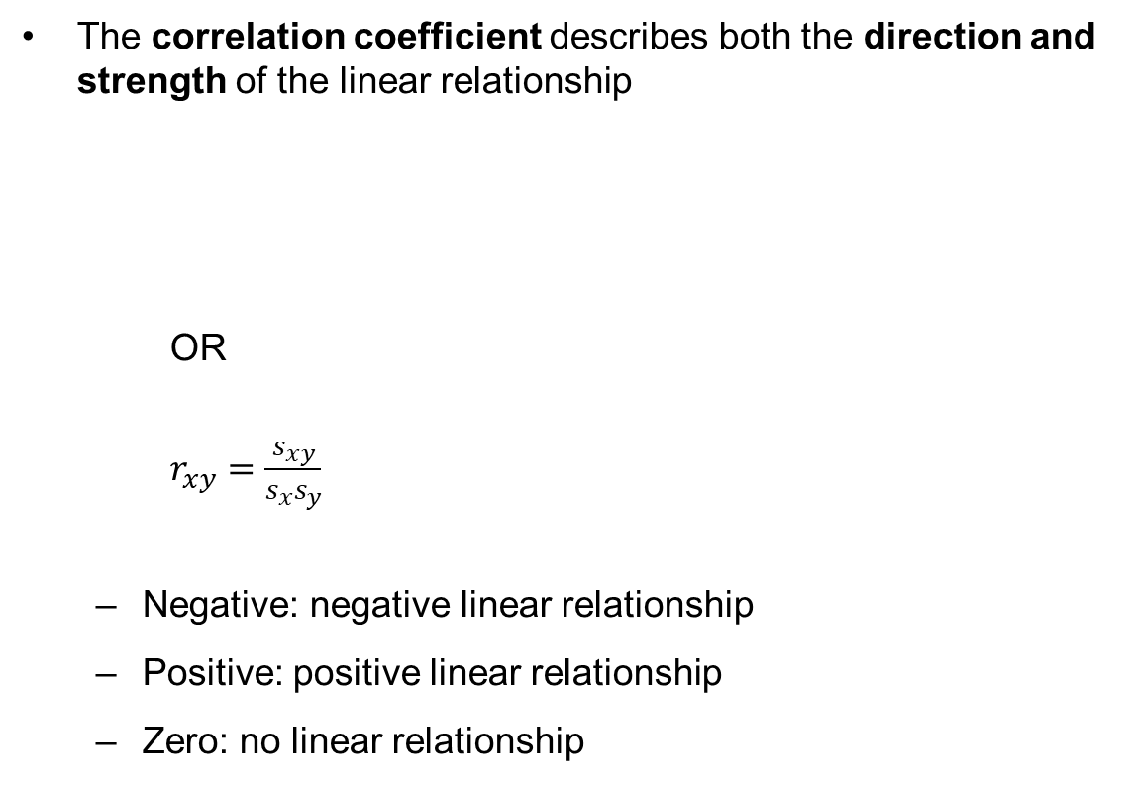
Covariance vs. Correlation Coefficient
The correlation coefficient describes both the direction and strength of the linear relationship
OR
$r_{xy}=\frac{s_{xy}}{s_{x}s_{y}}$
Negative: negative linear relationship
Positive: positive linear relationship
Zero: no linear relationship
The correlation is unit-free.
The correlation is between -1 and 1.
Correlation is -1: perfect negative linear relationship
Correlation is 0: not linearly related
Correlation is 1: perfect positive linear relationship

Slide 13
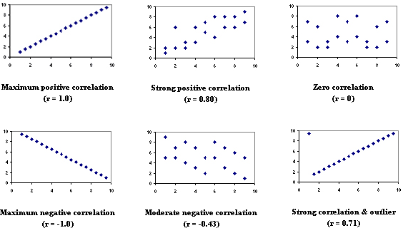
Correlation
Draw a scatterplot (look at the correlation coefficient if provided in the plot)
The scatterplots show different patterns of data show different correlations

Slide 14
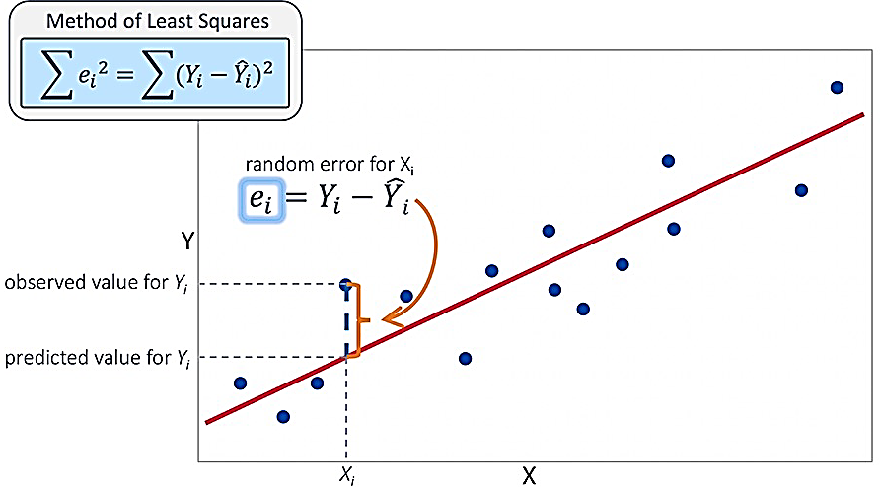
Intuition of Regression Line
The regression line is to a scatter diagram as the average is to a list.
The regression line of y on x estimates the average value of y corresponding to each value of x
The points on a scatter diagram deviate from the line by residuals (similar in size to the Root Mean Square error)
The root mean square error is to the regression line as the standard deviation is to the average
Regression model quality can be examined using residuals
Notes:
https://www.kaggle.com/discussions/getting-started/185146

Slide 15
Intuition of Regression Line
If the slope of line is negative, r is negative; and vice versa.
The strongest correlations (r = 1 and r = -1) occur when the data fall exactly on a straight line.
The correlation becomes weaker as the data points become more scattered.
If the data points fall in a random pattern, r=0.
Correlation coefficient is affected by outliers.

Slide 16
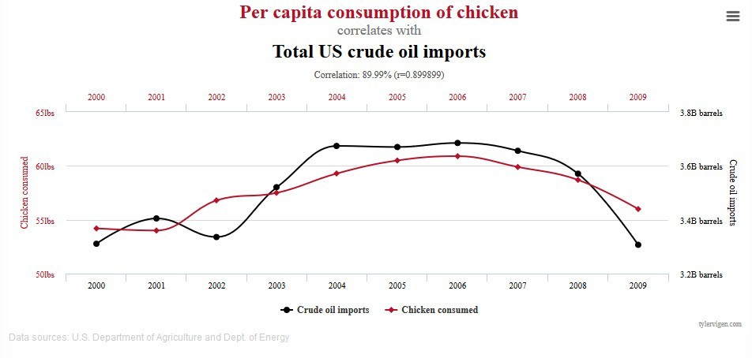
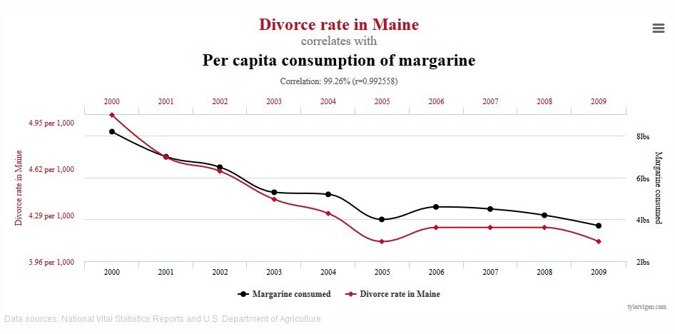
Intuition of Regression Line
But Correlation ≠ Causation

Slide 17

Why do we need a model?
The correlation coefficient
captures only a linear relationship
may not be a reliable measure in the presence of outliers
does not imply causation: Even if two variables are highly correlated, one does not necessarily cause the other
cannot be used for prediction
To predict values, we need a model: Regression Analysis

Slide 18

LR Model
response variable is influenced by explanatory variable(s).
Explanatory = input
Response = target
Use explanatory variable(s) to predict changes in the response variable.

Slide 19

LR Model
Predict exact value: Not possible (generally).
Response variable: Uniquely determined by explanatory variables ➔ relationship is deterministic.
Real life: relationship is generally stochastic.
Since we
omit relevant variables or
cannot measure the ones
that influence the response variable.

Slide 20

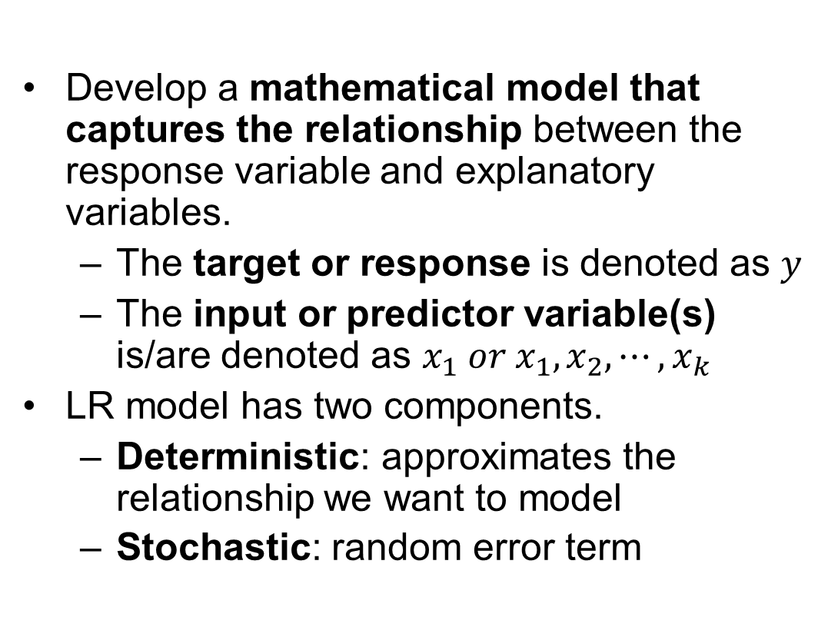
LR Model
Develop a mathematical model that captures the relationship between the response variable and explanatory variables.
The target or response is denoted as $y$
The input or predictor variable(s) is/are denoted as $x_{1} or{ x}_{1},x_{2},⋯,x_{k}$
LR model has two components.
Deterministic: approximates the relationship we want to model
Stochastic: random error term

Slide 21
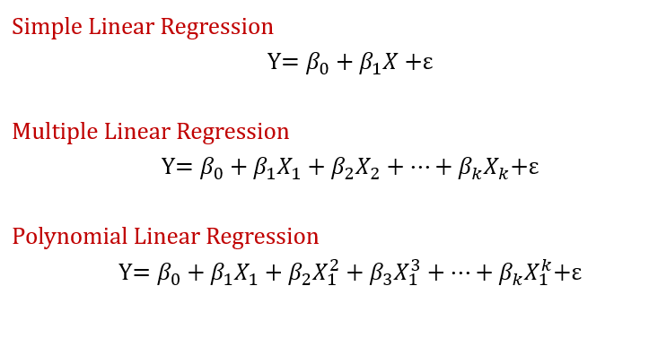
Simple, Multiple, Polynomial

Slide 22
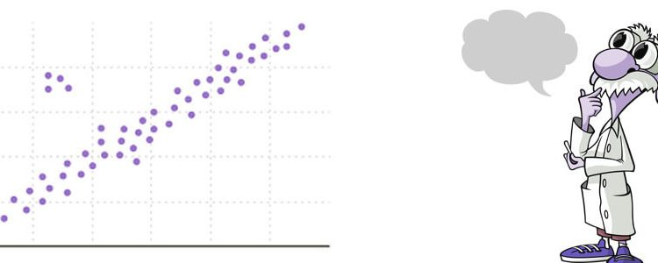
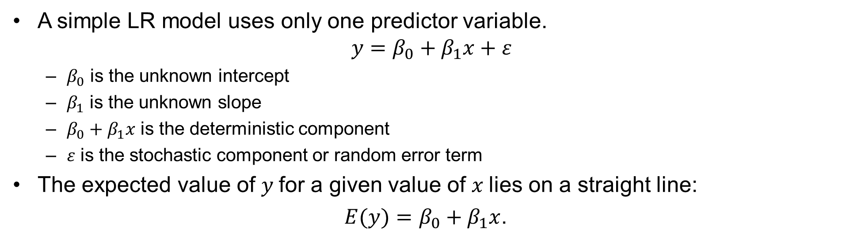
LR Model
A simple LR model uses only one predictor variable.
$$y=β_{0}+β_{1}x+ε$$
$β_{0}$ is the unknown intercept
$β_{1}$ is the unknown slope
$β_{0}+β_{1}x$ is the deterministic component
$ε$ is the stochastic component or random error term
The expected value of $y$for a given value of $x$lies on a straight line:
$E(y)=β_{0}+β_{1}x$.

Slide 23

LR Model
The slope parameter $β_{1}$ determines whether the linear relationship is positive or negative.
The population parameters $β_{0}$ and $β_{1}$ are unknown and must be estimated.

Slide 24
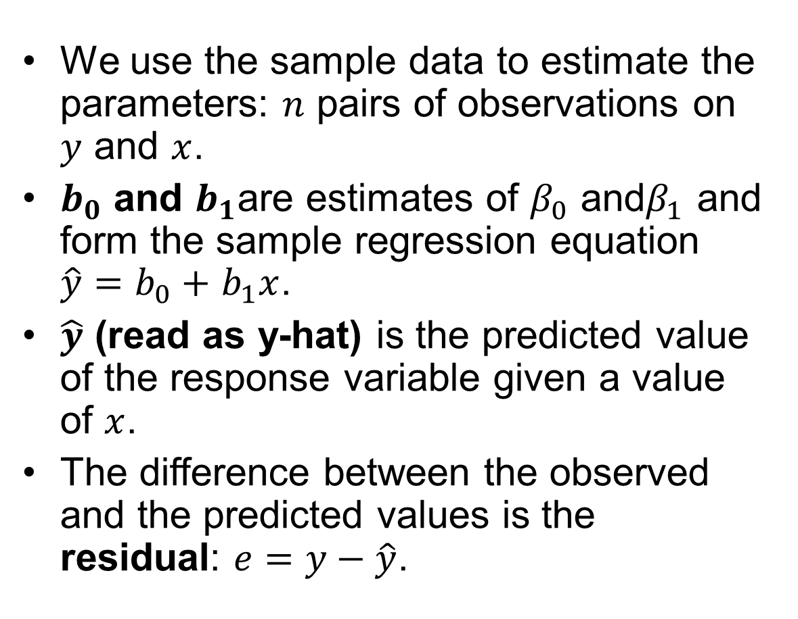
LR Model
We use the sample data to estimate the parameters: $n$ pairs of observations on $y$ and $x$.
$b_{0}$ and $b_{1}$are estimates of $β_{0}$ and$β_{1}$ and form the sample regression equation $\hat{y}=b_{0}+$ $b_{1}x$.
$\hat{y}$ (read as y-hat) is the predicted value of the response variable given a value of $x$.
The difference between the observed and the predicted values is the residual: $e=y−\hat{y}$.

Slide 25

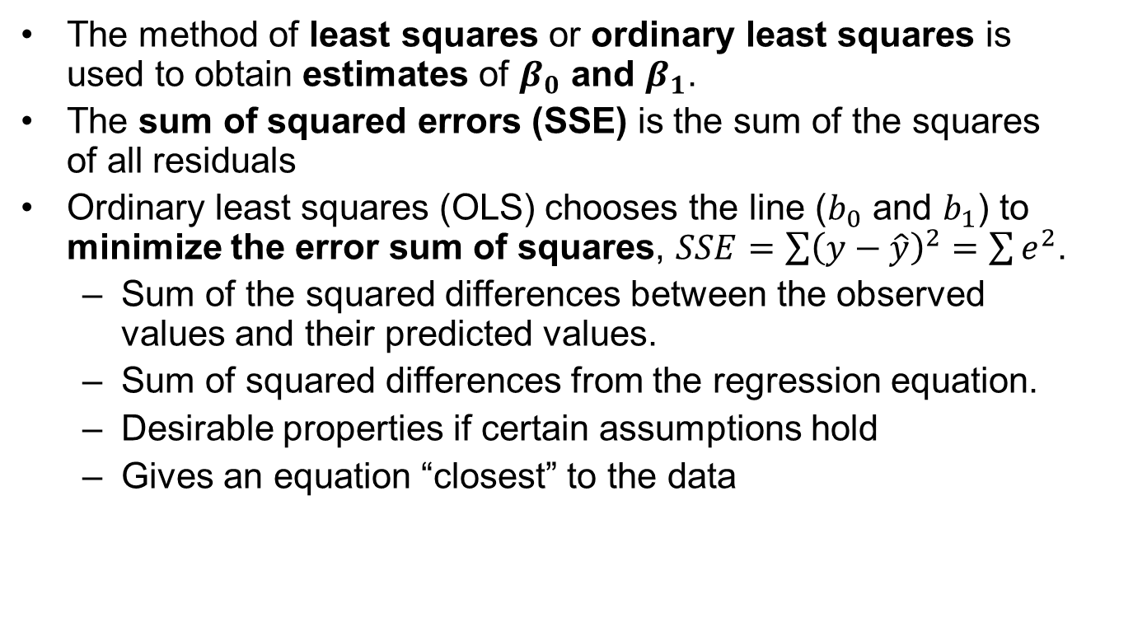
LR Model: Error
The method of least squares or ordinary least squares is used to obtain estimates of $β_{0}$ and $β_{1}$.
The sum of squared errors (SSE) is the sum of the squares of all residuals
Ordinary least squares (OLS) chooses the line ($b_{0}$ and $b_{1}$) to minimize the error sum of squares, $SSE=\sum{{\left(y−\hat{y}\right)}^{2}}=$ $\sum{e^{2}}$.
Sum of the squared differences between the observed values and their predicted values.
Sum of squared differences from the regression equation.
Desirable properties if certain assumptions hold
Gives an equation “closest” to the data
Notes:
Ordinary least squares (OLS) is a type of linear least squares method for choosing the unknown parameters in a LR model (with fixed level-one effects of a linear function of a set of explanatory variables) by the principle of least squares: minimizing the sum of the squares of the differences between the observed dependent variable (values of the variable being observed) in the input dataset and the output of the (linear) function of the independent variable.

Slide 26
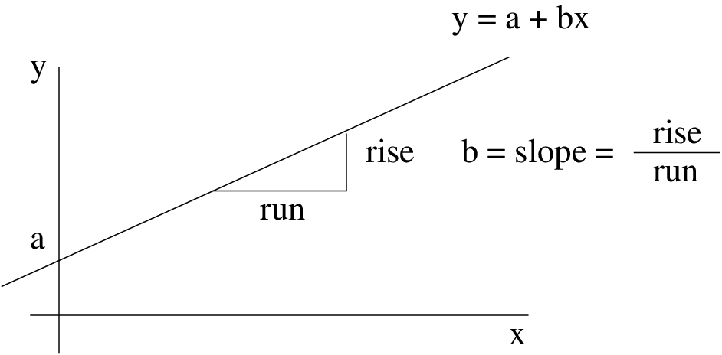
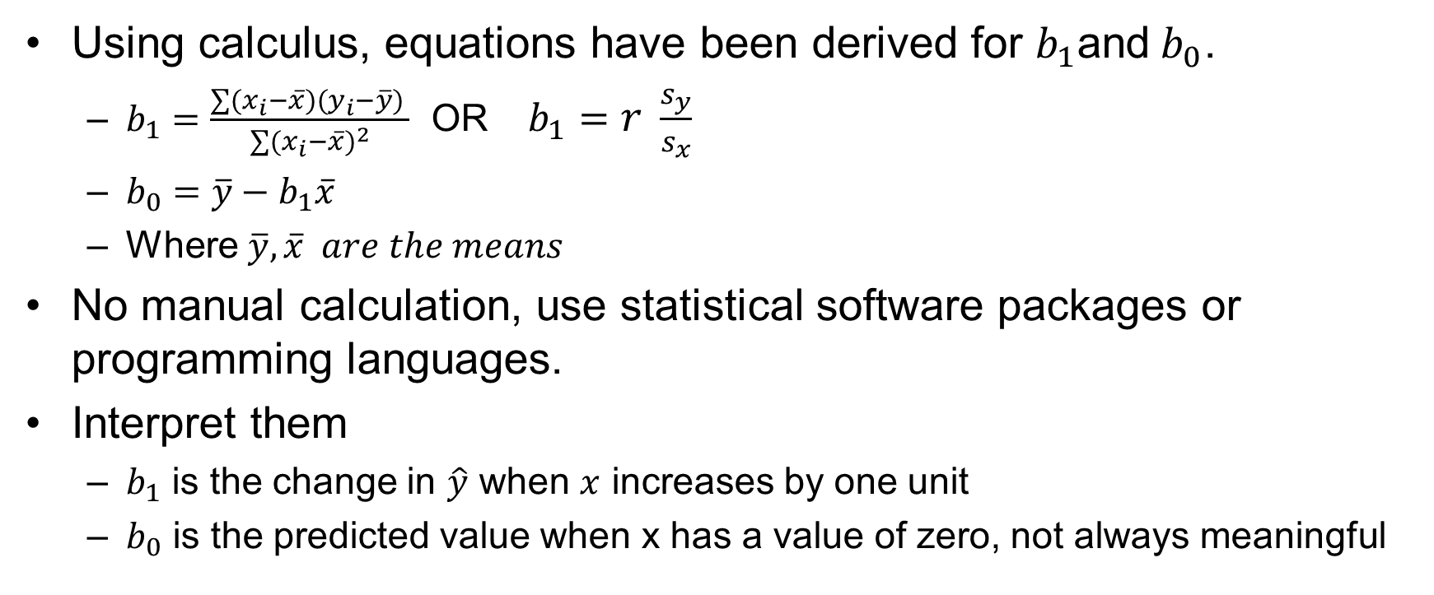
LR Model: Intercept and Slope
Using calculus, equations have been derived for $b_{1}$and${ b}_{0}$.
$b_{1}=\frac{\sum{(x_{i}−\overline{x})(y_{i}−\overline{y}) }}{\sum{{(x_{i}−\overline{x})}^{2}}}$ OR $b_{1}=r \frac{s_{y}}{s_{x}}$
$b_{0}=\overline{y}−b_{1}\overline{x}$
Where $\overline{y}, \overline{x} are the means$
No manual calculation, use statistical software packages or programming languages.
Interpret them
$b_{1}$ is the change in $\hat{y}$ when $x$ increases by one unit
$b_{0}$ is the predicted value when x has a value of zero, not always meaningful

Slide 27
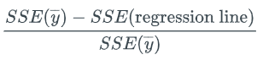
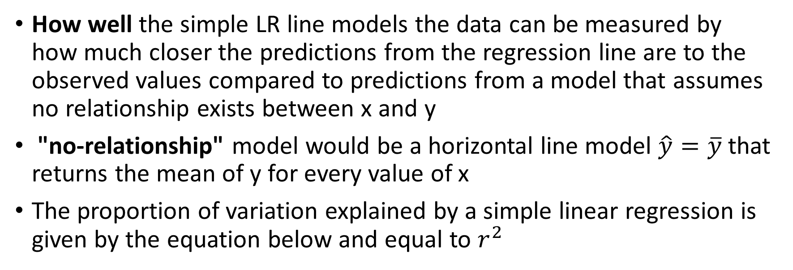
LR Model
How well the simple LR line models the data can be measured by how much closer the predictions from the regression line are to the observed values compared to predictions from a model that assumes no relationship exists between x and y
"no-relationship" model would be a horizontal line model $\hat{y}=\overline{y}$that returns the mean of y for every value of x
The proportion of variation explained by a simple linear regression is given by the equation below and equal to $r^{2}$

Slide 28
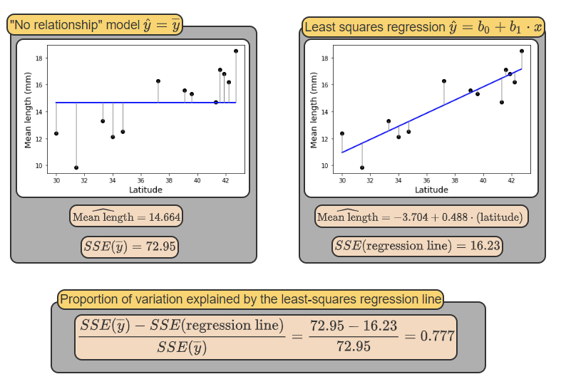
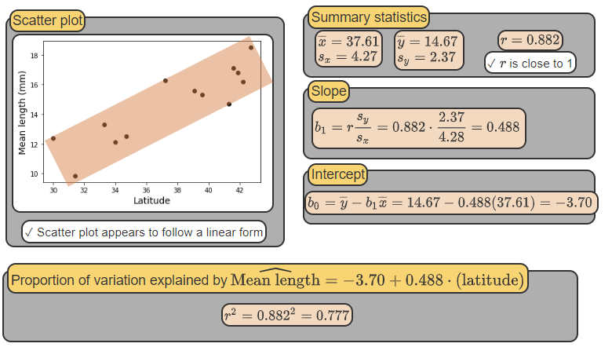
Notes:
https://learn.zybooks.com/zybook/UNTADTA5340OrhanFall2023/chapter/7

Slide 29

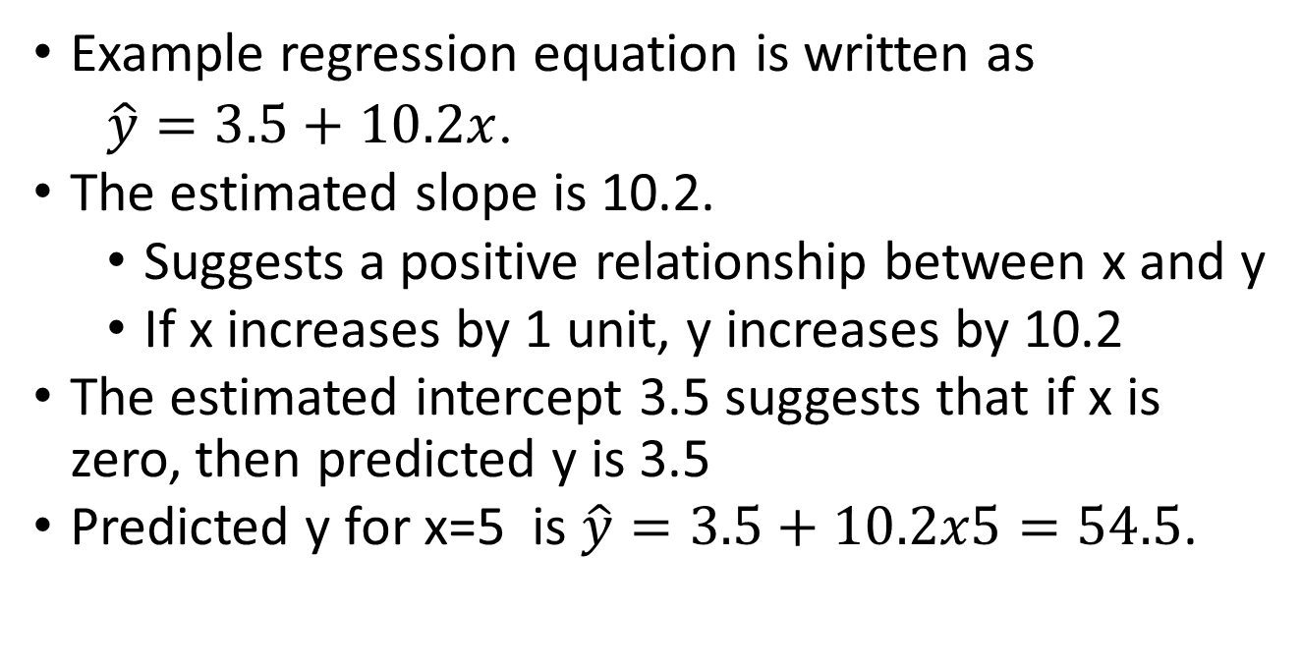
Example
Example regression equation is written as
$\hat{y}=3.5+$ $10.2x$.
The estimated slope is 10.2.
Suggests a positive relationship between x and y
If x increases by 1 unit, y increases by 10.2
The estimated intercept 3.5 suggests that if x is zero, then predicted y is 3.5
Predicted y for x=5 is $\hat{y}=3.5+$ $10.2x5=54.5$.

Slide 30
Single vs. Multiple LR Model
Simple LR uses only a single explanatory variable.
This might reduce the usefulness of the model.
A multiple LR model allows us to examine how the response is influenced by two or more explanatory variables.

Slide 31

Assumptions

Slide 32
Design and Data
Standard linear regression assumes a single numerical response variable
The explanatory variables can be numerical or categorical
Categorical variables recoded into a set of dichotomous “dummy” variables
Number of variables and cases
Outliers

Slide 33
Design and Data
Assuming a linear relationship between the explanatory and response variables
Y = a₀ + a₁X₁ +…+ a_{p}X_{p} + ε
ε is a normally distributed error term that does not depend on that values of the explanatory variable
Check the assumption using residual plots

Slide 34
Design and Data – Dummy Variables
Dummy variable is a variable with only two possible outcomes. For analysis, one of the outcomes is coded a 1 and the other a 0. (e.g., Yes/No m=2)
If a categorical variable has m levels (m>2), it needs to be converted into m-1 dummy variables. (e.g., Yes/No/Maybe m=3)
If assuming the slope associated with a numerical independent variable does not change with the categorical variable, no interaction term of them will be included

Slide 35
Design and Data – Number of Variables and Observations
Generally, approximately 30 observations for one independent variable
A good guideline: add at least an additional 10 observations for each additional predictor added to the equation
The number of independent variables limited by 2 factors
Predictors included in the equation only if they influence the dependent variable based on well-defined model
Variables should be considered for elimination if they do not contribute substantially to explaining the variance in the dependent variable (total R²)
After a main effect model has been determined, interactions between terms should be investigated (proceed with caution)
An interaction between variables x₁ and x₂ can be represented by adding the term x₁· x₂

Slide 36

Detecting and Handling Outliers

Slide 37
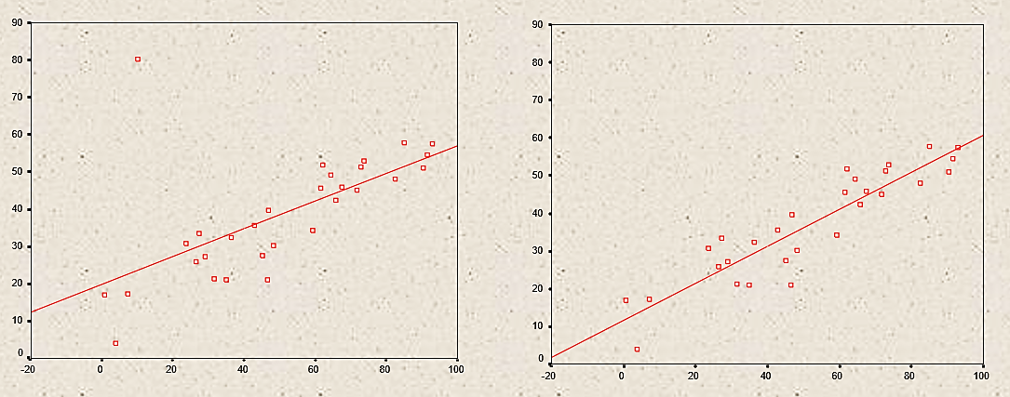
Design and Data – Outliers
Outliers can affect regression solution
Outliers can represent under-sampled groups or anomalous data
A more representative sample is needed for the former
Consider excluding data points for the latter case

Slide 38
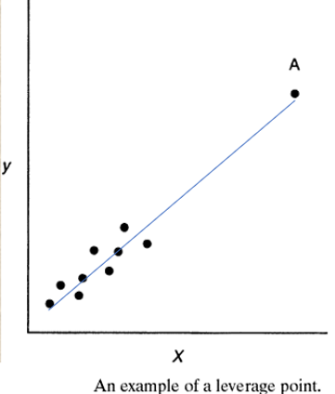
Importance of Detecting Influential Observations
Leverage Point
Unusual x-value
Can have very little effect on the model, e.g., with or without A, the regression line will be about the same

Slide 39
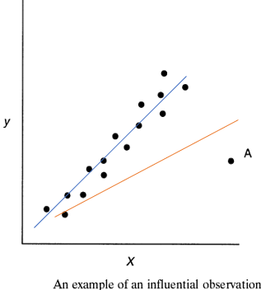
Importance of Detecting Influential Observations
Influential Point
Regression lines with & without observation A are very different
Need to be detected!

Slide 40

Handling Influential Observations
Should an influential point be discarded?
Yes, if
there is an error in the measured value
the sample point is invalid
the observation is not part of the population that was intended to besampled
No, if
the sample point is valid

Slide 41

Multiple LR

Slide 42
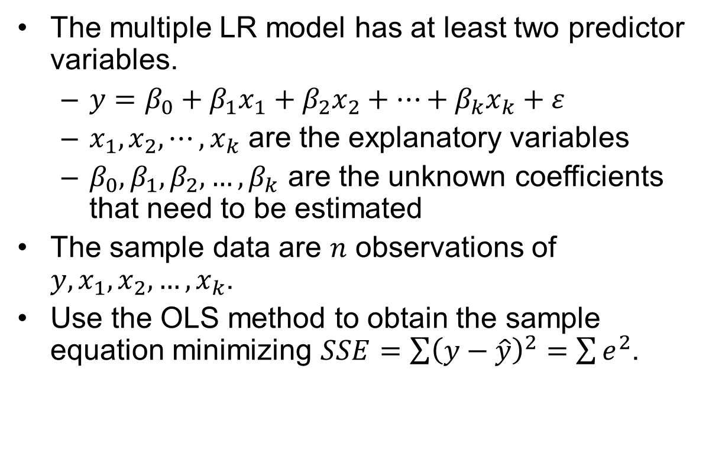
Multiple LR
The multiple LR model has at least two predictor variables.
$y=β_{0}+β_{1}x_{1}+β_{2}x_{2}+…+β_{k}x_{k}+ε$
$x_{1},x_{2},⋯,x_{k}$ are the explanatory variables
$β_{0},β_{1},β_{2},…,β_{k}$ are the unknown coefficients that need to be estimated
The sample data are $n$ observations of $y,x_{1},x_{2},…,x_{k}$.
Use the OLS method to obtain the sample equation minimizing $SSE=\sum{{\left(y−\hat{y}\right)}^{2}}=$ $\sum{e^{2}}$.

Slide 43

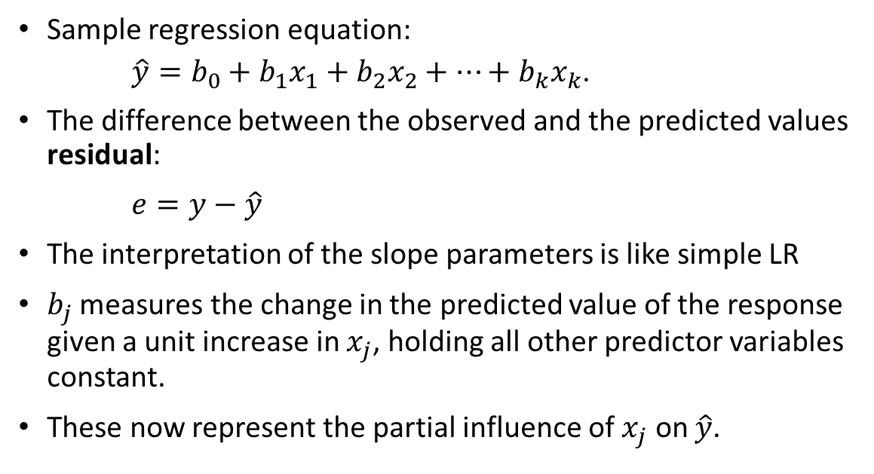
Multiple LR
Sample regression equation:
$\hat{y}=b_{0}+b_{1}x_{1}+b_{2}x_{2}+…+b_{k}x_{k}$.
The difference between the observed and the predicted values residual:
$e=y−\hat{y}$
The interpretation of the slope parameters is like simple LR
$b_{j}$ measures the change in the predicted value of the response given a unit increase in $x_{j}$, holding all other predictor variables constant.
These now represent the partial influence of $x_{j}$ on $\hat{y}$.

Slide 44

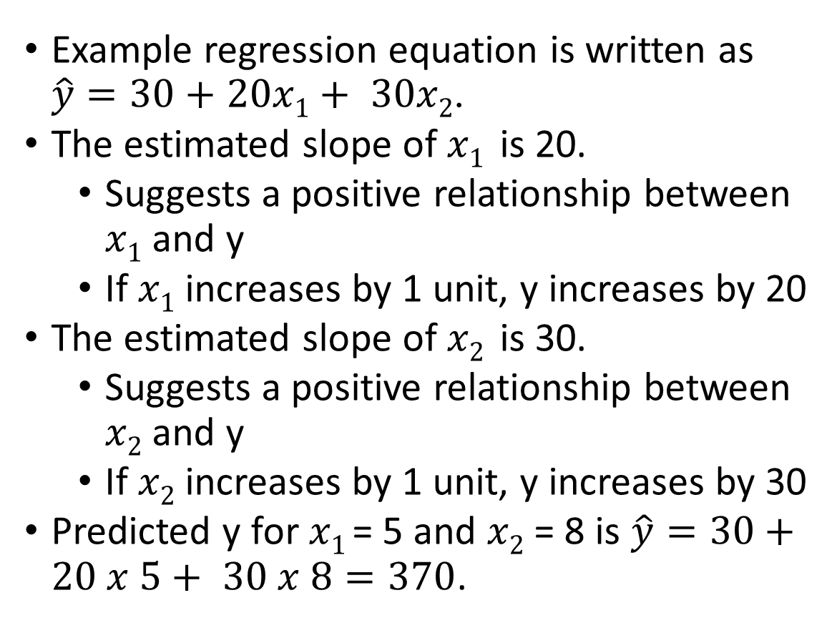
Example
Example regression equation is written as $\hat{y}=30+$ $20x1+ 30x2$.
The estimated slope of $x1$ is 20.
Suggests a positive relationship between $x1$ and y
If $x1$ increases by 1 unit, y increases by 20
The estimated slope of $x2$ is 30.
Suggests a positive relationship between $x2$ and y
If $x2$ increases by 1 unit, y increases by 30
Predicted y for $x1$= 5 and $x2$ = 8 is $\hat{y}=30+$ $20 x 5+ 30 x 8=370$.

Slide 45
Multiple LR Assumptions
There is a linear relationship
The mean of error term is zero
The error term has constant variance
The errors are independent
The errors follow the normal distribution
No multicollinearity

Slide 46
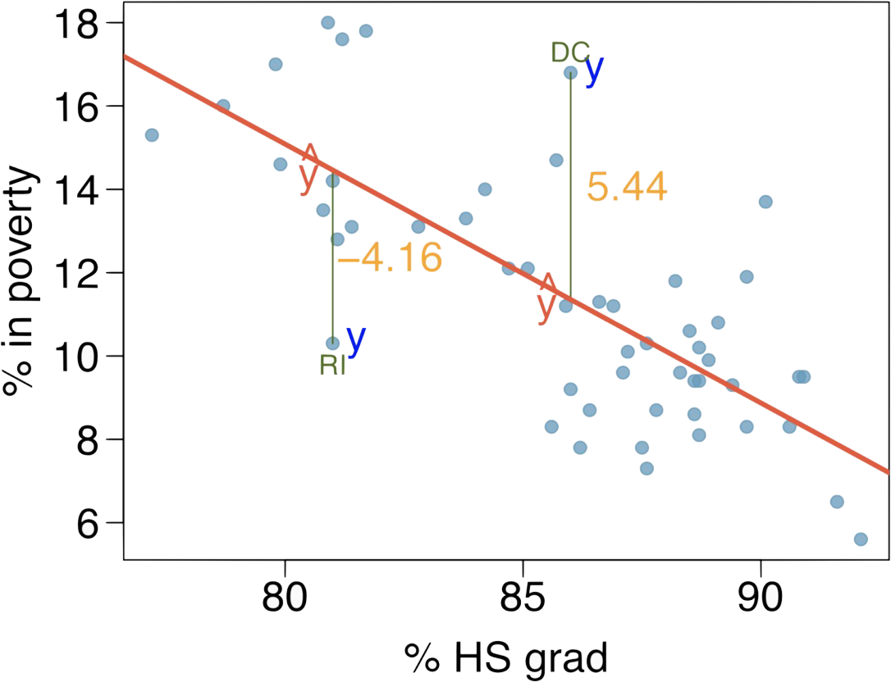
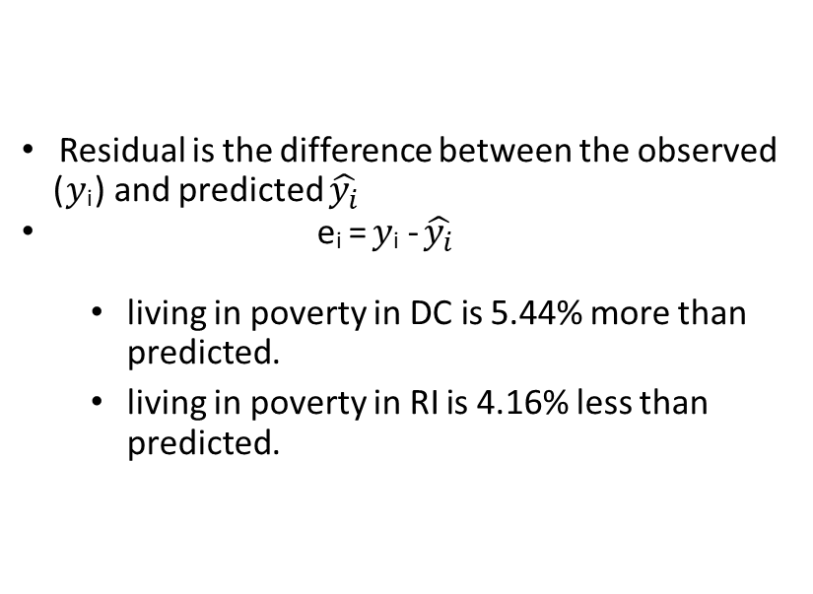
Residuals
Residual is the difference between the observed (𝑦_{i}) and predicted $\hat{y_{i}}$
e_{i} = 𝑦_{i} - $\hat{y_{i}}$
living in poverty in DC is 5.44% more than predicted.
living in poverty in RI is 4.16% less than predicted.

Slide 47

Residuals to Validate Assumptions
The residuals are examined to determine if the differences between the predicted and observed values are random (unpredictable)
There should be no explanatory/predictive information in the error portion of the model
The residuals represent the error
Intuitively, the deterministic portion of the model should be explaining (predicting) the response variable with nothing left over but randomness
If there is explanatory or predictive power in the error, then the model is missing components

Slide 48
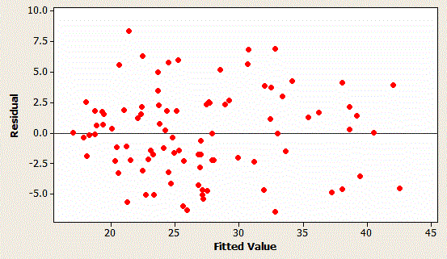
Residuals to Validate Assumptions
Residuals should not be either systematically high or low
They should be centered on zero throughout the range of fitted values
Residuals should have constant spread throughout the range
Model should be correct on average for all fitted values
Residuals should be approximately normally distributed
Ideal residual plot: these residuals indicate a good regression model

Slide 49

Residuals to Validate Assumptions
A non-random pattern in the residuals signals that the model is missing explanatory information
Missing variable(s)
Missing higher-order term of a variable
Missing interaction between terms
Time dependency (autocorrelation)

Slide 50
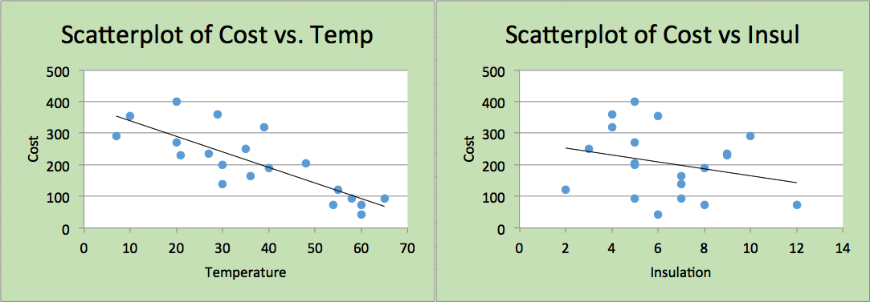
Linear Relationship Assumption
The relationship between the dependent variable and the set of independent variables is linear
To verify this assumption, develop a scatter diagram for the dependent variable vs each independent variable
E.g., Below indicate a fairly strong negative relationship between temperature and heating cost and negative relationship between insulation and costs

Slide 51
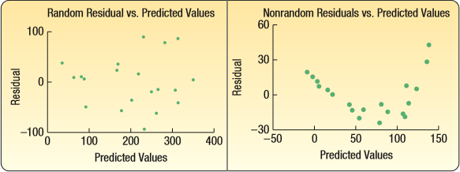
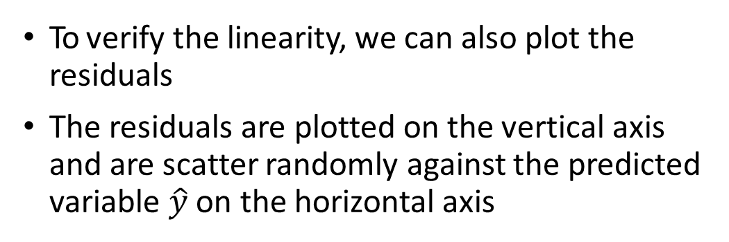
Linear Relationship Assumption
To verify the linearity, we can also plot the residuals
The residuals are plotted on the vertical axis and are scatter randomly against the predicted variable $\hat{y}$ on the horizontal axis

Slide 52
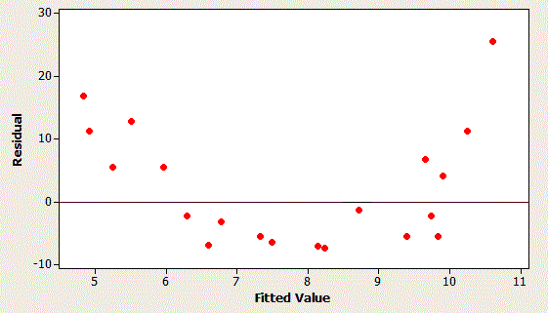
Linear Relationship Assumption
These residuals indicate a problem with the regression model

Slide 53
Linear Relationship Assumption
To better conform to linearity assumption, variables can be transformed
100
100
80
80
60
60
40
40
20
20
0
0
-20
-20
-10
0
10
20
-20
-20
0
20
40
60
80
100
Take model to be Y = X² + ε

Slide 54
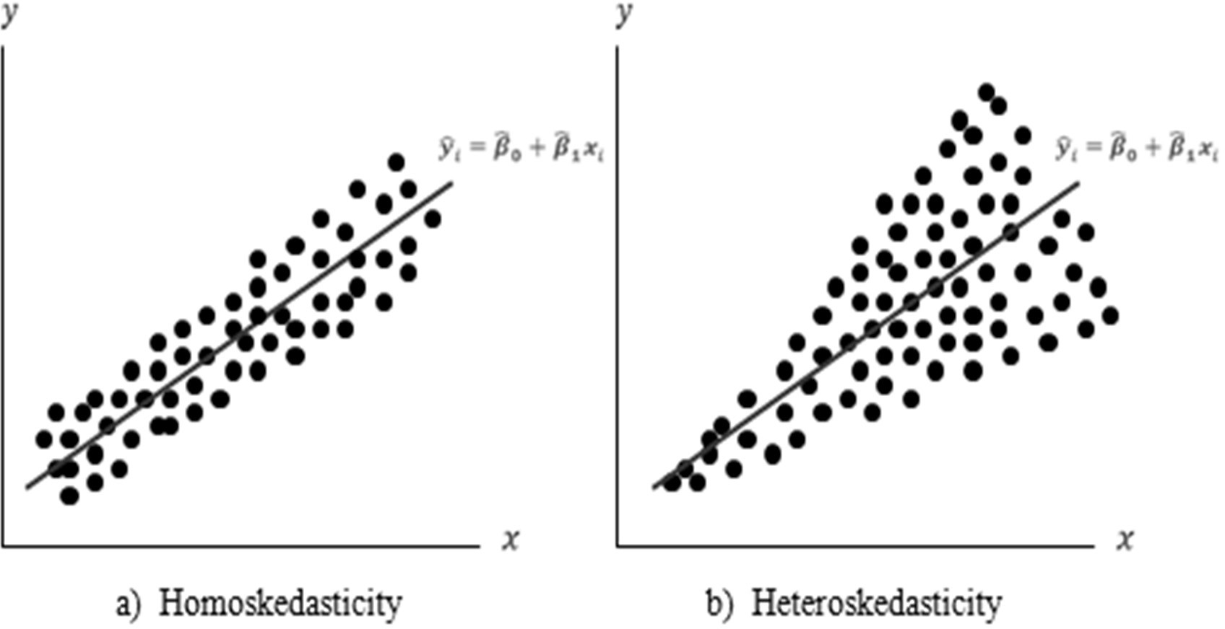
Constant Variance Assumption
The error term has constant variance
Homoscedasticity – the variation around the regression equation is the same for all values of the independent variables.

Slide 55
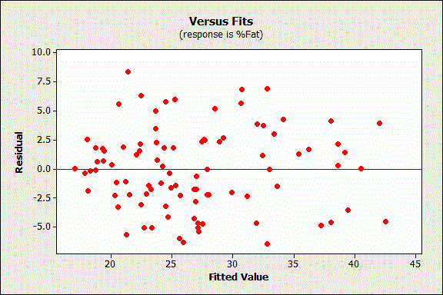
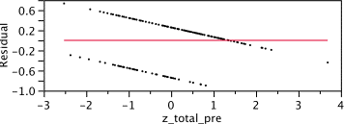
Zero Mean Assumption
The mean of error term is zero
To verify this, use a scatterplot to check whether the mean of the distribution of the residuals is 0
These residuals indicate a problem

Slide 56
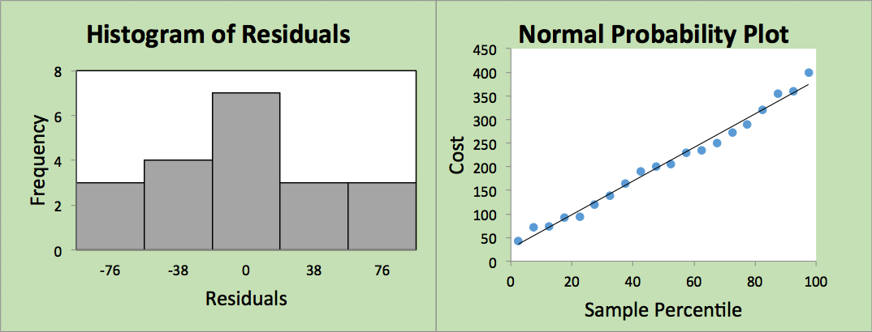
Normal Probability Assumption
The errors follow the normal distribution
To verify this, use a histogram or a normal probability plot of residuals
If the plotted points are fairly close to the reference line, the normal probability assumption is supported

Slide 57
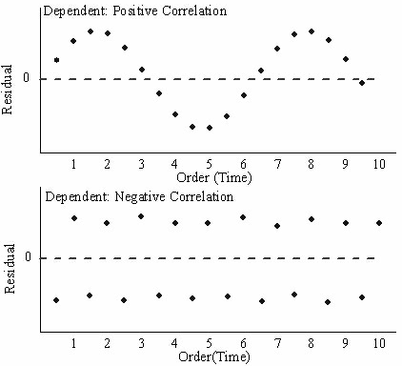
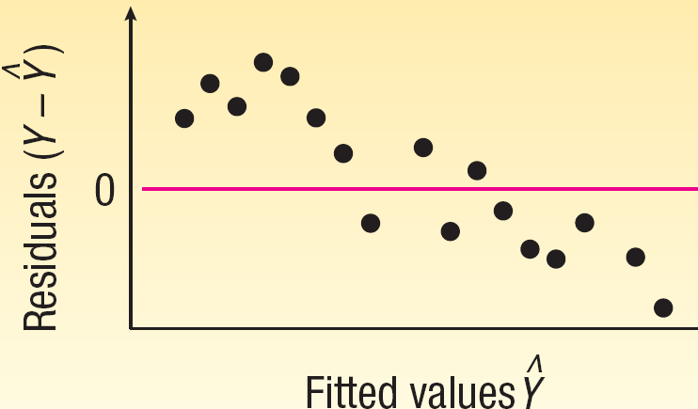
Independence Assumption
The errors are assumed to be independent
Autocorrelation occurs when successive residuals are correlated
If it exists, the value of the standard error will be biased and leads to poor hypothesis tests of coefficients
Notes:
https://www.originlab.com/doc/origin-help/residual-plot-analysis

Slide 58
Logistic regression

Slide 59
Logistic Regression
• Logistic Regression is similar to linear regression, except Logistic Regression predicts whether something is true or false instead of predicting something continuous like age.
• Logistic regression determines the probability of the target event, p, as a function of the input variables.
• Probabilities are defined in the [0,1] interval; the response function is S-shaped.

Slide 60

An Example: Hurricane Harvey Evacuations
Did you evacuate your home to go some place safer before Hurricane Harvey hit?
Response to this question is recorded in EVAC
YES
NO
DON'T KNOW
REFUSED

Slide 61

Logistic Regression Model Key Elements
Logit Link Function
Odds

Slide 62
Why Logit Link Function
EVAC PETS MOBLHOME TENURE EDUC
0 | 1 | 0 | 16 | 16
0 | 1 | 0 | 26 | 12
0 | 1 | 1 | 11 | 13
1 | 1 | 1 | 1 | 10
1 | 0 | 0 | 5 | 12
0 | 0 | 0 | 34 | 12
0 | 0 | 0 | 3 | 14
0 | 1 | 0 | 3 | 16
0 | 1 | 0 | 10 | 12
0 | 0 | 0 | 2 | 18
0 | 0 | 0 | 2 | 12
0 | 1 | 0 | 25 | 16
1 | 1 | 1 | 20 | 12
An Example: Hurricane Harvey Evacuations
Target variable: EVAC
Predictors: Pets, Moblhome, Tenure, Educ

Slide 63
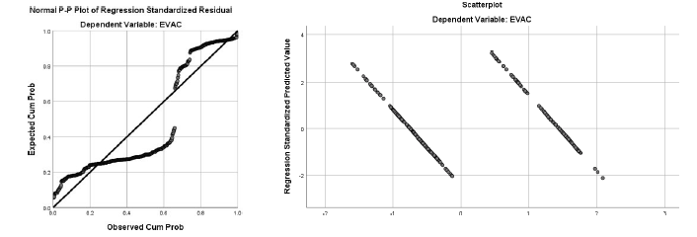
Why Logit Link Function
Evac = 0.275-0.135*PETS +0.363*MOBLHOME-0.004*TENURE+0.011*EDUC
Predicted Values can be outside [0,1]
Violated assumptions

Slide 64
Why Logit Link Function
Set p = probability of the observation belonging to class 1
Relate p to predictors with a function that guarantees 0 ≤ p ≤ 1
Standard linear function does not constrain the probability
𝑝 = 𝛽₀ + 𝛽₁𝑥₁ + 𝛽₂𝑥₂ + ⋯ 𝛽_{q}𝑥_{q}
q = number of predictors

Slide 65

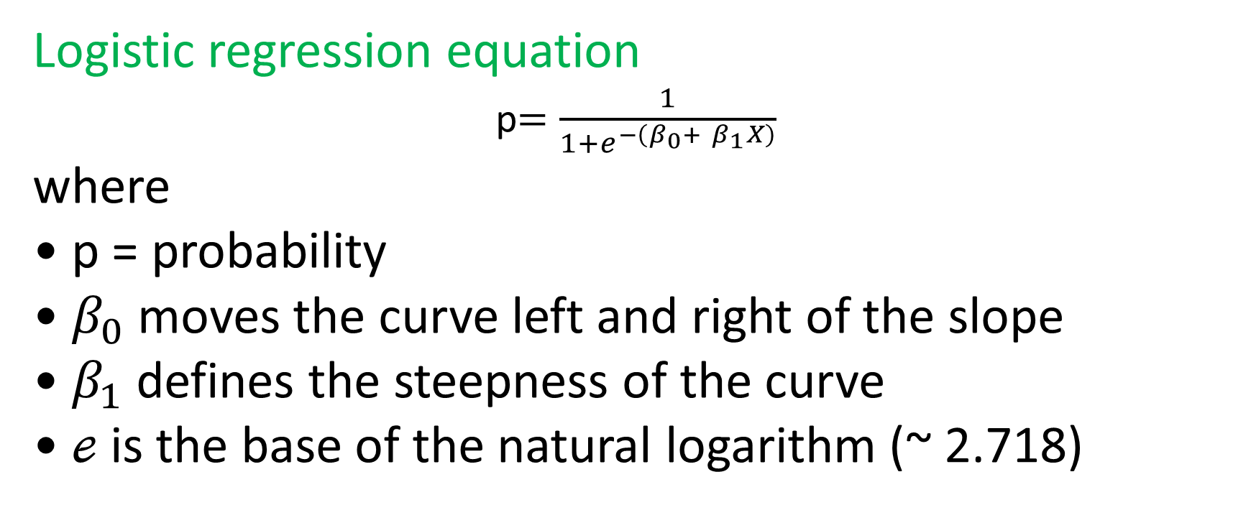
Logistic Regression
Logistic regression equation
p$=\frac{1}{{1+e}^{−\left(β_{0}+ β_{1}X\right)}}$
where
• p = probability
• $β_{0}$moves the curve left and right of the slope
• $β_{1}$defines the steepness of the curve
• ℯ is the base of the natural logarithm (~ 2.718)

Slide 66
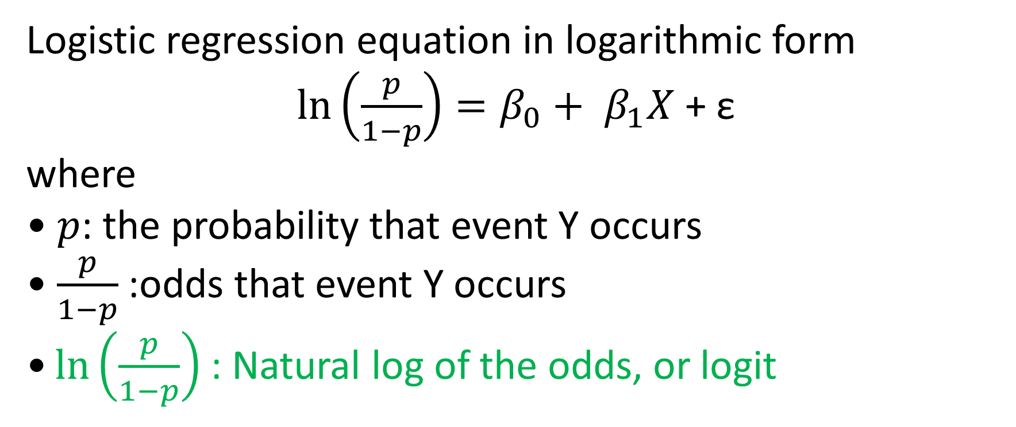
Logistic regression equation in logarithmic form
$\ln\left(\frac{p}{1−p}\right)=β_{0}+ β_{1}X$ + ε
where
• 𝑝: the probability that event Y occurs
• $\frac{p}{1−p}$:odds that event Y occurs
$\text{•}\ln\left(\frac{p}{1−p}\right)$: Natural log of the odds, or logit

Slide 67
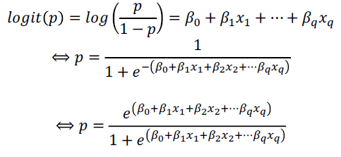
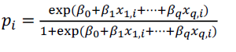
Logit Link Function
logit(p) is just a shortcut for log(p/1-p), where p = P{Y = 1}
For ith observation,

Slide 68
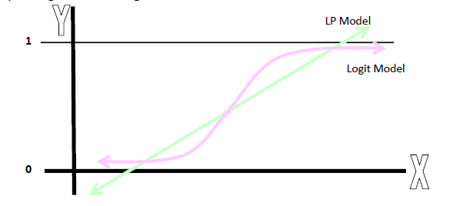
Logit Link Function
Comparing LP and Logit Models

Slide 69


Odds
The odds of an event is
Given the odds, the probability of the event, e.g., p(Y=1) is
Odds₁/Odds₂ is the odds ratio comparing two odds

Slide 70


Odds
If there is a 75% chance that it will rain tomorrow, then 3 out of 4 times we say this it will rain. That means for every three times it rains once it will not. The odds of it raining tomorrow is 3 to 1.
If the odds that my pony will win the race is 1 to 3, that means for every 4 races it runs, it will win 1 and lose 3.

Slide 71

Odds in the Logistic Regression

Slide 72
Odds in the Logistic Regression
Review the relationship between logit, odds and probability.
The log of odds, i.e., logit function of probability, takes values from -infinity to +infinity
The linear function of predictors x₁, x₂, … also takes values from -infinity to +infinity

Slide 73

Assumptions and Interpretations

Slide 74

Assumptions
Dichotomous outcome variable (usually coded as “1” and “0”)
The categories of the outcome variable are exhaustive and mutually exclusive i.e., each observation in the study must be a member of one group but not both
Independent observations
Correctly specified model: it includes all relevant predictors and excludes irrelevant predictors (essential for all statistical analyses, although not always explicitly stated as a model assumption)

Slide 75



Interpreting Coefficients
The coefficient 𝛽_{i} represents the change in the log odds as 𝑥_{i} changes while holding other independent variables constant. (Not a useful interpretation)
The marginal effect of a change in 𝑥_{i} on the probability is
(Not an easy interpretation)

Slide 76
Interpreting Coefficients
Better to interpret coefficients in terms of odds ratio
exp(𝛽_{i}) represents the odds ratio—the effect of one-unit change of 𝑥_{i} on the odds while holding other independent variables constant
For instance, log(odds)=-13.70837 + 0.1685 x₁ + 0.0039 x₂
exp(0.1685) = 1.18 is the effect of one-unit increase in x₁ on the odds. Specifically, the odds increase by 18% if incrementing x₁ regardless of the other values

Slide 77
Example Logistic Regression Output
How does the odds of evacuation for someone who lived in mobile home compared to that for those from brick-and-mortar home?
 | coef b | s.e. | Wald | p-value | exp(b) | lower | upper
Intercept | -1.015 | 0.688 | 2.178 | 0.140 | 0.362
PETS | -0.640 | 0.201 | 10.144 | 0.001 | 0.527 | 0.356 | 0.782
MOBLHOME | 1.586 | 0.286 | 30.649 | 0.000 | 4.885 | 2.786 | 8.564
TENURE | -0.020 | 0.008 | 6.113 | 0.013 | 0.980 | 0.965 | 0.996
EDUC | 0.057 | 0.047 | 1.473 | 0.225 | 1.058 | 0.966 | 1.159
Households that are mobile homes have 4.88 times odds to evacuate as those from brick-and-mortar homes.

Slide 78
Example Logistic Regression Output - Hypothesis Testing
 | coef b | s.e. | Wald | p-value | exp(b) | lower | upper
Intercept | -1.015 | 0.688 | 2.178 | 0.140 | 0.362
PETS | -0.640 | 0.201 | 10.144 | 0.001 | 0.527 | 0.356 | 0.782
MOBLHOME | 1.586 | 0.286 | 30.649 | 0.000 | 4.885 | 2.786 | 8.564
TENURE | -0.020 | 0.008 | 6.113 | 0.013 | 0.980 | 0.965 | 0.996
EDUC | 0.057 | 0.047 | 1.473 | 0.225 | 1.058 | 0.966 | 1.159
The Wald statistic for the 𝛽 coefficient is Wald = [𝛽 /s.e._{B}]² following a chi-square distribution with 1 degree of freedom
The Wald Chi-Square statistic, which tests the unique contribution of each predictor holding constant the other predictors i.e., eliminating any overlap between predictors.

Slide 79
Example Logistic Regression Output - Calculate Probability
What is the probability of evacuation for someone without pets, who has lived in their brick-and-mortar home for 20 years, with 18 years of education?
 | coef b
Intercept | -1.015
PETS | -0.640
MOBLHOME | 1.586
TENURE | -0.020
EDUC | 0.057
Logit = -1.015 – 0.640*PETS + 1.586*MOBLHOME – 0.020*TENURE + 0.057*EDUC
Logit = -1.015 – 0.640*0 + 1.586*0 – 0.020*20 + 0.057*18 = -0.389
Odds = e^{logit} = e^{-0.389}= 0.677
Probability (of Evacuation)= Odds / (1+Odds) = 0.404

Slide 80

Another Example
fake example we have predictors study_hours and female to determine the chances of passing an exam.
logit(p) = 0.5 + 0.13 * study_hours + 0.97 * female
Ip = P{Y=1} is the probability of passing a math exam.
Let’s pick study_hours and see how it impacts the chances of passing the exam.
Increasing the study hours by 1 unit (1 hour) will result in a 0.13 increase in logit(p) or log(p/1-p).
Now, if log(p/1–p) increases by 0.13, that means that p/(1 — p) will increase by exp(0.13) = 1.14.
This is a 14% increase in the odds of passing the exam (the variable female remains constant).
Notes:
https://towardsdatascience.com/a-simple-interpretation-of-logistic-regression-coefficients-e3a40a62e8cf

Slide 81
Another Example
fake example we have predictors study_hours and female to determine the chances of passing an exam.
logit(p) = 0.5 + 0.13 * study_hours + 0.97 * female
Ip = P{Y=1} is the probability of passing a math exam.
Let’s also interpret the impact of being a female on passing the exam.
We know that exp(0.97) = 2.64.
The odds for passing the exam are 164% higher for women.
Notes:
https://towardsdatascience.com/a-simple-interpretation-of-logistic-regression-coefficients-e3a40a62e8cf

Slide 82

Data Normalization/Standardization
Different range or scale of variables is not a problem for Logistic regression
Logistic regression does NOT require normalization/standardization

Slide 83

Multicollinearity
Multicollinearity is a common problem for linear and generalized linear models.
Multicollinearity will not lead to biased coefficients.
But the standard errors of the coefficients will be inflated.
If a variable which should be statistically significant is not, consult the correlation coefficients.
If two variables are correlated at a rate greater than 0.6, 0.7, 0.8, etc. drop the least theoretically important of the two.

Slide 84

Matrix Approach to calculate 𝛽s
There are a variety of approaches that will allow you to calculate 𝛽 estimates.
The Matrix Approach is a more efficient method to compute the coefficient estimates
• Very useful for multiple linear regression
• Easy to program
• Easy to analyze large data sets
Python libraries use matrix representations
• NumPy
• Scikit-learn
• TensorFlow

Slide 85


Slide 86

Linear vs. Logistic Regression

Slide 87

Examples
Notes:
two_d_arr_from_reshape = one_d_arr.reshape(-1, 1) two_d_arr_from_reshapearray([[2020], [1992], [1972]])two_d_arr_from_reshape.shape(3, 1)Let’s unpack that code. We passed a 1 so the the second dimension — the columns — got a 1.
We passed a negative integer for the other dimension. That means the remaining dimension becomes whatever shape is needed to make it hold all the original data.
Think of -1 as fill in the blank to make a dimension so that all the data has a home. 🏠
In this case you end up with a 2D array with 3 rows and 1 column. -1 took on the value 3.
It’s a good practice to make our code flexible so that it can handle how many ever observations we throw at it. So instead of hard-coding both dimensions, use -1. 🙂

Slide 88


Slide 90


Slide 91

Hot encoding
A nonlinear regression model can be used to predict the outcome of a categorical feature based on numeric features.
But categorical features must first be made numeric.
Hot encoding is transforming a categorical feature into numeric feature that equal 0 when an instance is not in the category and 1 when the instance is.
https://towardsdatascience.com/encoding-categorical-variables-one-hot-vs-dummy-encoding-6d5b9c46e2db

Slide 92

Python Linear Regression
import
Read data
Fit LinearRegression() object to (X,y) where
X is an array of the observed values of the input feature and
y is an array representing the numerical variable.
Then reshape X and y
Plot probabilities of predicted values

Slide 93



Slide 94


Slide 95
Python Logistic Regression
import
Read data
Fit LogisticRegression() object to (X,y) where
X is an array of the observed values of the input feature and
y is an array of 0s and 1s representing the binary categorical variable.
If the categorical variable has not been hot encoded, values can be reassigned from labels to 0 or 1 using pandas DataFrame operations.
Then reshape X and y
Plot probabilities of predicted values

Slide 96

Notes:
https://www.w3schools.com/python/python_ml_logistic_regression.asp

Slide 97


Slide 98

3.78 0.61 The probability that a tumor with the size 3.78cm is cancerous is 61%.
2.44 0.19 The probability that a tumor with the size 2.44cm is cancerous is 19%.
2.09 0.13 The probability that a tumor with the size 2.09cm is cancerous is 13%.

Slide 99




Slide 100


